Slide 1

Lecture # 1 Overview of the Course
DS602 - Tools and Techniques for Data Science
Lecture # 4
Danish Hamid

Slide 2


Slide 3
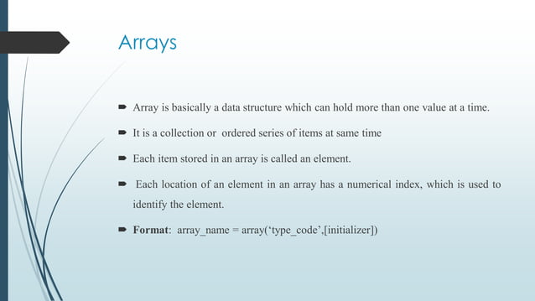

Slide 4
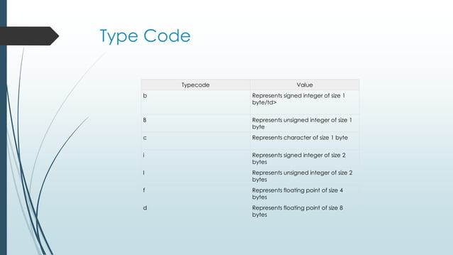

Slide 5
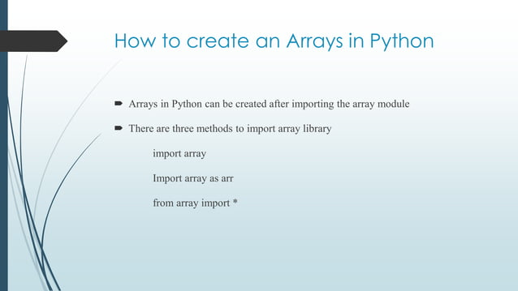

Slide 6
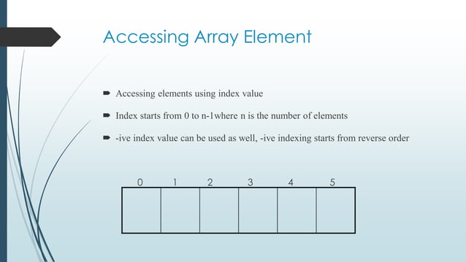

Slide 7
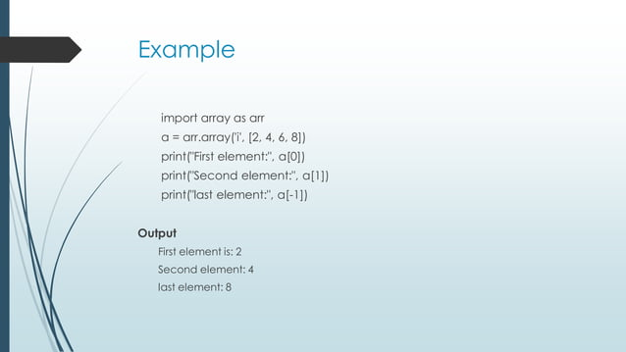

Slide 8
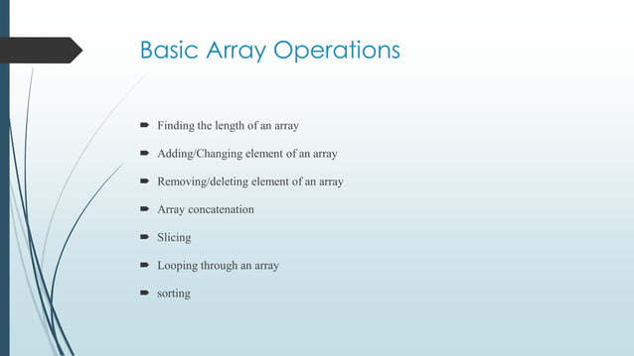

Slide 9
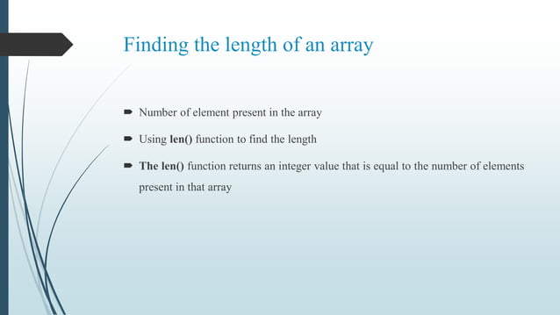

Slide 10
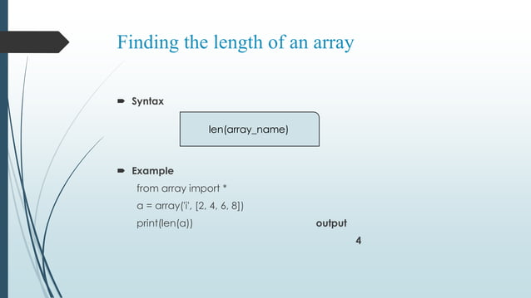

Slide 11
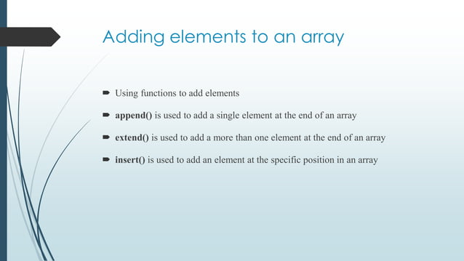

Slide 12
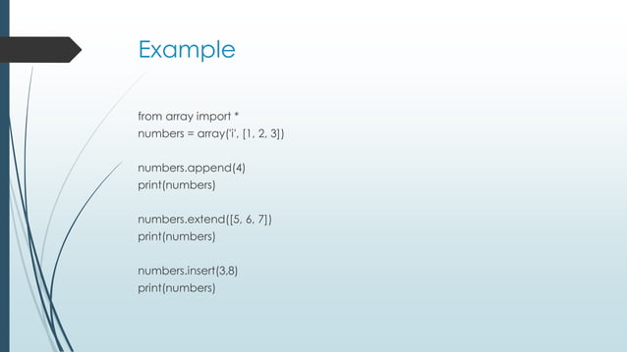

Slide 13
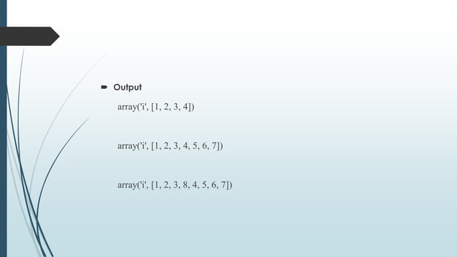

Slide 14
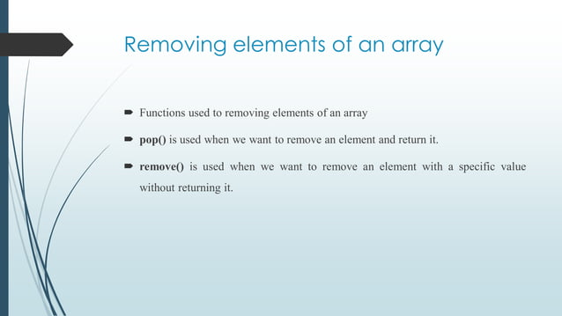

Slide 15


Slide 16
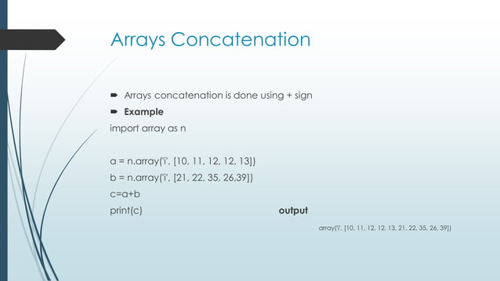

Slide 17
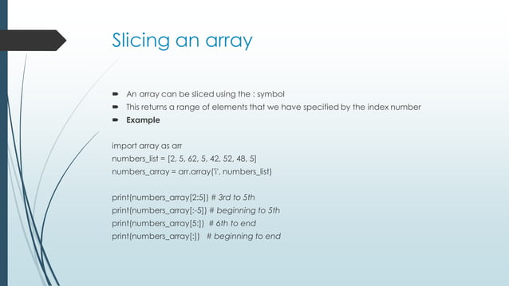

Slide 18
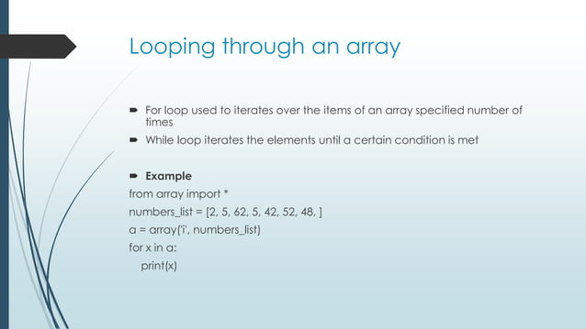

Slide 19
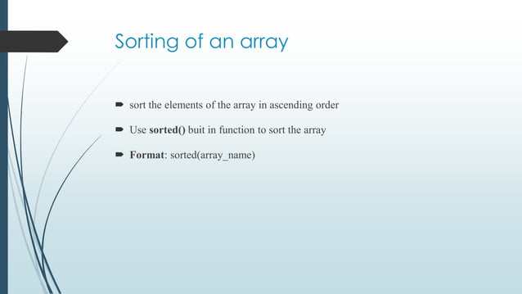

Slide 20
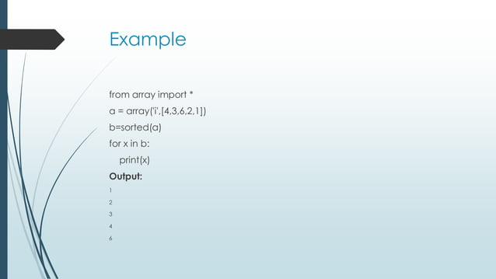

Slide 21
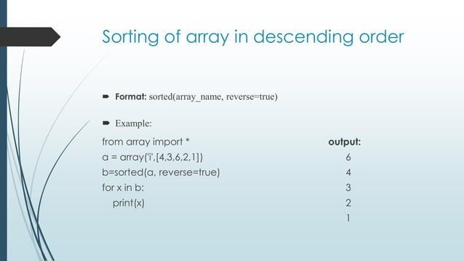

Slide 22
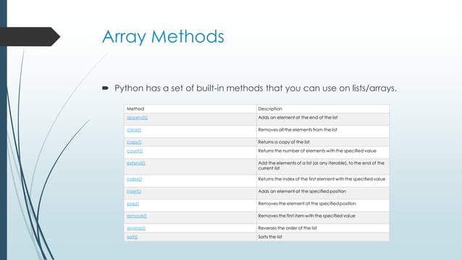

Slide 23
10. Python - Lists
The list is a most versatile datatype available in Python, which can be written as a list of comma-separated values (items) between square brackets. Good thing about a list that items in a list need not all have the same type:
Creating a list is as simple as putting different comma-separated values between squere brackets. For example:
list1 = ['physics', 'chemistry', 1997, 2000];
list2 = [1, 2, 3, 4, 5 ];
list3 = ["a", "b", "c", "d"];
Like string indices, list indices start at 0, and lists can be sliced, concatenated and so on.

Slide 24
Accessing Values in Lists:
To access values in lists, use the square brackets for slicing along with the index or indices to obtain value available at that index:
Example:
  list1 = ['physics', 'chemistry', 1997, 2000];
  list2 = [1, 2, 3, 4, 5, 6, 7 ];
  print "list1[0]: ", list1[0]
  print "list2[1:5]: ", list2[1:5]
This will produce following result:
  list1[0]: physics
  list2[1:5]: [2, 3, 4, 5]

Slide 25
Updating Lists:
You can update single or multiple elements of lists by giving the slice on the left-hand side of the assignment operator, and you can add to elements in a list with the append() method:
Example:
  list1 = ['physics', 'chemistry', 1997, 2000];
  print "Value available at index 2 : "
  print list1[2];
  list1[2] = 2001;
  print "New value available at index 2 : "
  print list1[2];
This will produce following result:
  Value available at index 2 :
  1997
  New value available at index 2 :
  2001

Slide 26
Delete List Elements:
To remove a list element, you can use either the del statement if you know exactly which element(s) you are deleting or the remove() method if you do not know.
Example:
  list1 = ['physics', 'chemistry', 1997, 2000];
  print list1;
  del list1[2];
  print "After deleting value at index 2 : "
  print list1;
This will produce following result:
  ['physics', 'chemistry', 1997, 2000]
  After deleting value at index 2 :
  ['physics', 'chemistry', 2000]

Slide 27
Basic List Operations:
Lists respond to the + and * operators much like strings; they mean concatenation and repetition here too, except that the result is a new list, not a string.
In fact, lists respond to all of the general sequence operations we used on strings in the prior chapter :
Python Expression | Results | Description
len([1, 2, 3]) | 3 | Length
[1, 2, 3] + [4, 5, 6] | [1, 2, 3, 4, 5, 6] | Concatenation
['Hi!'] * 4 | ['Hi!', 'Hi!', 'Hi!', 'Hi!'] | Repetition
3 in [1, 2, 3] | TRUE | Membership
for x in [1, 2, 3]: print x, | 1 2 3 | Iteration

Slide 28
Indexing, Slicing, and Matrixes:
Because lists are sequences, indexing and slicing work the same way for lists as they do for strings.
Assuming following input:
L = ['spam', 'Spam', 'SPAM!']
Python Expression | Results | Description
L[2] | 'SPAM!' | Offsets start at zero
L[-2] | 'Spam' | Negative: count from the right
L[1:] | ['Spam', 'SPAM!'] | Slicing fetches sections

Slide 29
Built-in List Functions & Methods:
SN | Function with Description
1 | cmp(list1, list2) Compares elements of both lists.
2 | len(list) Gives the total length of the list.
3 | max(list) Returns item from the list with max value.
4 | min(list) Returns item from the list with min value.
5 | list(seq) Converts a tuple into list.

Slide 30
SN | Methods with Description
1 | list.append(obj)
 | Appends object obj to list
2 | list.count(obj)
 | Returns count of how many times obj occurs in list
3 | list.extend(seq)
 | Appends the contents of seq to list
4 | list.index(obj)
 | Returns the lowest index in list that obj appears
5 | list.insert(index, obj)
 | Inserts object obj into list at offset index
6 | list.pop(obj=list[-1])
 | Removes and returns last object or obj from list
7 | list.remove(obj)
 | Removes object obj from list
8 | list.reverse()
 | Reverses objects of list in place
9 | list.sort([func])
 | Sorts objects of list, use compare func if given

Slide 31
11. Python - Tuples
A tuple is a sequence of immutable Python objects. Tuples are sequences, just like lists. The only difference is that tuples can't be changed ie. tuples are immutable and tuples use parentheses and lists use square brackets.
Creating a tuple is as simple as putting different comma-separated values and optionally you can put these comma-separated values between parentheses also. For example:
  tup1 = ('physics', 'chemistry', 1997, 2000);
  tup2 = (1, 2, 3, 4, 5 );
  tup3 = "a", "b", "c", "d";
The empty tuple is written as two parentheses containing nothing:
tup1 = ();
To write a tuple containing a single value you have to include a comma, even though there is only one value:
tup1 = (50,);
Like string indices, tuple indices start at 0, and tuples can be sliced, concatenated and so on.

Slide 32
Accessing Values in Tuples:
To access values in tuple, use the square brackets for slicing along with the index or indices to obtain value available at that index:
Example:
  tup1 = ('physics', 'chemistry', 1997, 2000);
  tup2 = (1, 2, 3, 4, 5, 6, 7 );
  print "tup1[0]: ", tup1[0]
  print "tup2[1:5]: “, tup2[1:5]
This will produce following result:
  tup1[0]: physics
  tup2[1:5]: [2, 3, 4, 5]

Slide 33
Updating Tuples:
Tuples are immutable which means you cannot update them or change values of tuple elements. But we able able to take portions of an existing tuples to create a new tuples as follows:
Example:
  tup1 = (12, 34.56);
  tup2 = ('abc', 'xyz');
  tup3 = tup1 + tup2;
  print tup3;
This will produce following result:
(12, 34.56, 'abc', 'xyz')

Slide 34
Delete Tuple Elements:
Removing individual tuple elements is not possible. There is, of course, nothing wrong with putting together another tuple with the undesired elements discarded.
To explicitly remove an entire tuple, just use the del statement:
Example:
  tup = ('physics', 'chemistry', 1997, 2000);
  print tup;
  del tup;
  print "After deleting tup : " print tup;
This will produce following result.
  ('physics', 'chemistry', 1997, 2000)
  After deleting tup : Traceback (most recent call last): File "test.py", line 9, in <module> print tup; NameError: name 'tup' is not defined

Slide 35
Basic Tuples Operations:
Tuples respond to the + and * operators much like strings; they mean concatenation and repetition here too, except that the result is a new tuple, not a string.
In fact, tuples respond to all of the general sequence operations we used on strings in the prior chapter :
Python Expression | Results | Description
len((1, 2, 3)) | 3 | Length
(1, 2, 3) + (4, 5, 6) | (1, 2, 3, 4, 5, 6) | Concatenation
['Hi!'] * 4 | ('Hi!', 'Hi!', 'Hi!', 'Hi!') | Repetition
3 in (1, 2, 3) | TRUE | Membership
for x in (1, 2, 3): print x, | 1 2 3 | Iteration

Slide 36
Indexing, Slicing, and Matrixes:
Because tuples are sequences, indexing and slicing work the same way for tuples as they do for strings.
Assuming following input:
L = ('spam', 'Spam', 'SPAM!')
Python Expression | Results | Description
L[2] | 'SPAM!' | Offsets start at zero
L[-2] | 'Spam' | Negative: count from the right
L[1:] | ['Spam', 'SPAM!'] | Slicing fetches sections

Slide 37
No Enclosing Delimiters:
Any set of multiple objects, comma-separated, written without identifying symbols, i.e., brackets for lists, parentheses for tuples, etc., default to tuples, as indicated in these short examples:
  print 'abc', -4.24e93, 18+6.6j, 'xyz';
  u, v = 1, 2;
  print "Value of u , v : ", u,v;
  print var;
This will reduce following result:
  abc -4.24e+93 (18+6.6j) xyz
  Value of u , v : 1 2

Slide 38
Built-in Tuple Functions:
SN | Function with Description
1 | cmp(tuple1, tuple2)
 | Compares elements of both tuples.
2 | len(tuple)
 | Gives the total length of the tuple.
3 | max(tuple)
 | Returns item from the tuple with max value.
4 | min(tuple)
 | Returns item from the tuple with min value.
5 | tuple(seq)
 | Converts a list into tuple.

Slide 39


Slide 40
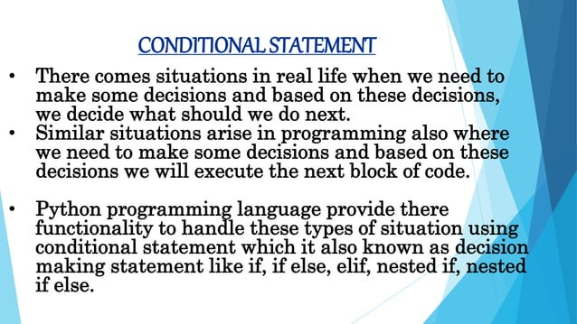

Slide 41
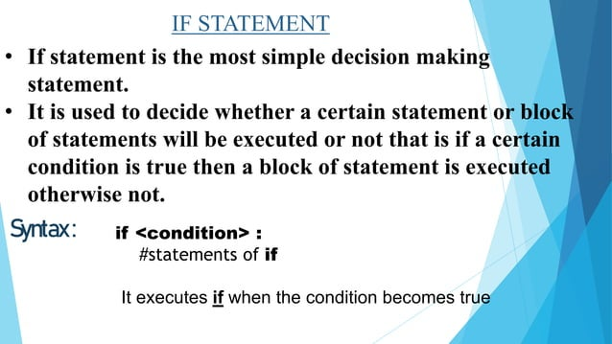

Slide 42
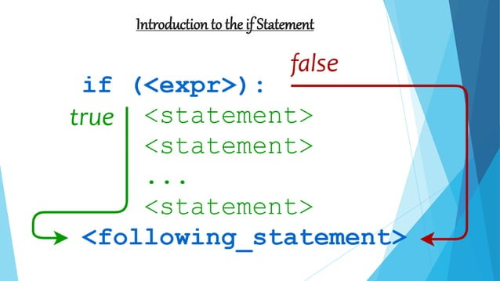

Slide 43
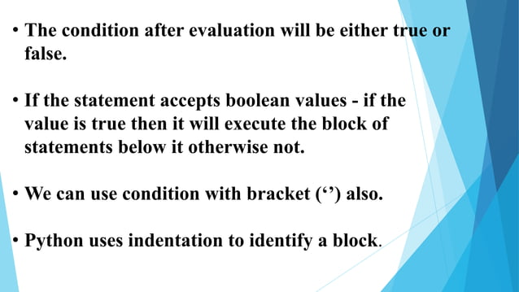

Slide 44
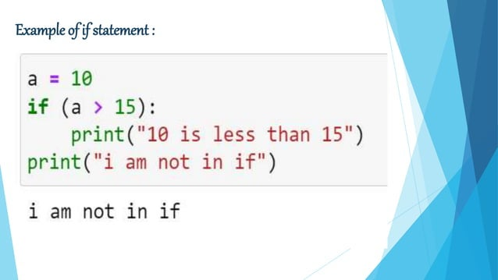

Slide 45
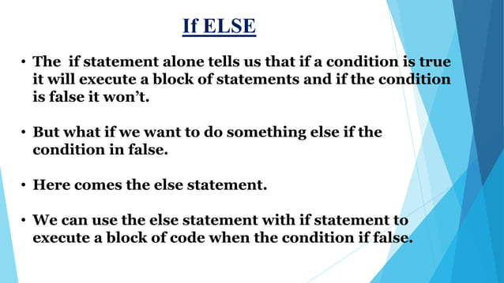

Slide 46
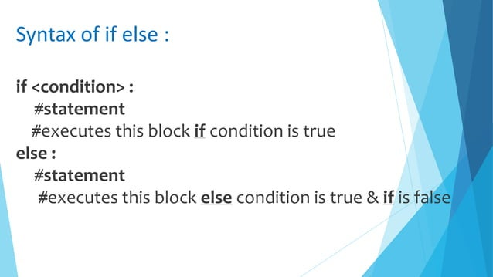

Slide 47
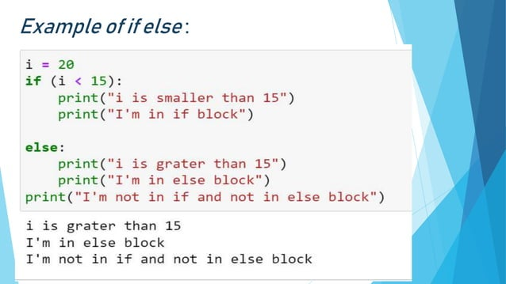

Slide 48
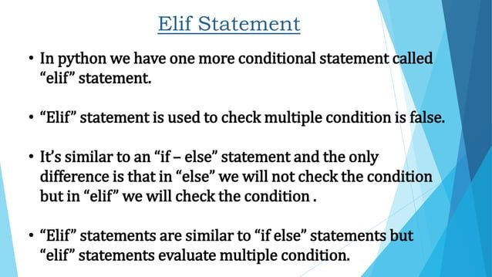

Slide 49
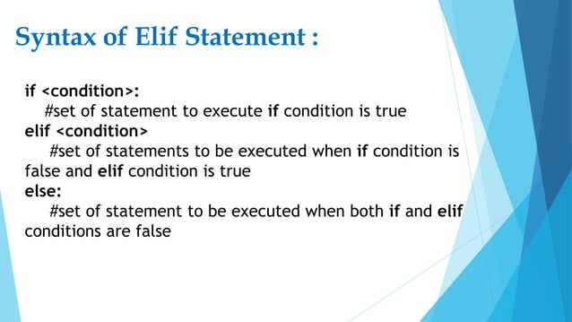

Slide 50
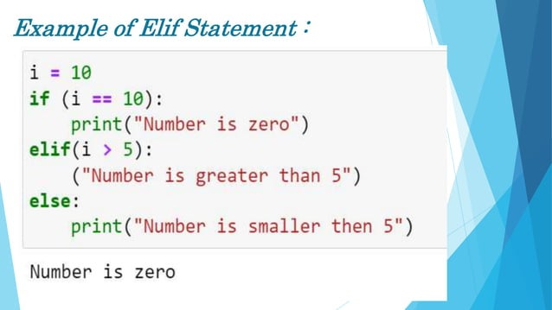

Slide 51
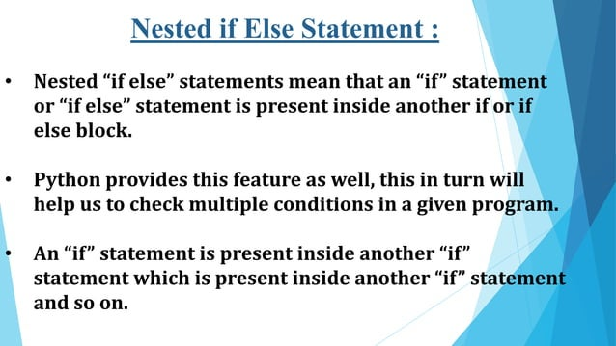

Slide 52
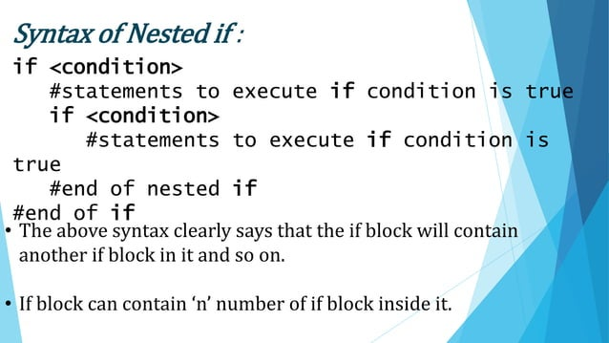

Slide 53
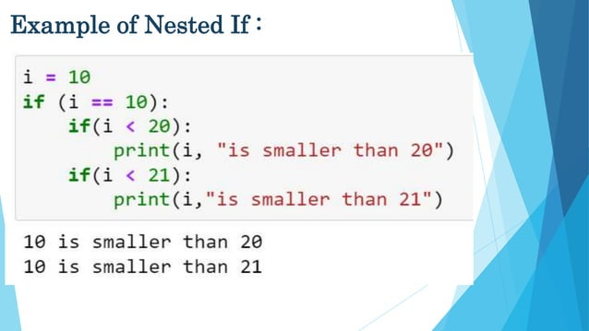

Slide 54
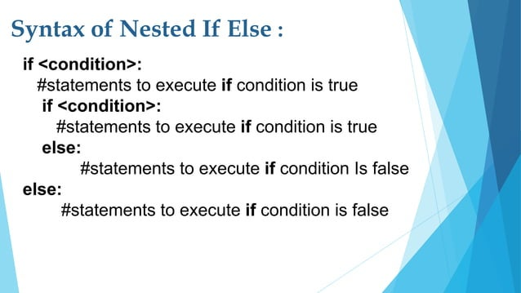

Slide 55
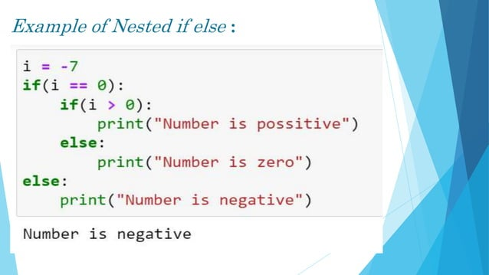

Slide 56
Loops and Iteration
Notes:
Note from Chuck. If you are using these materials, you can remove the UM logo and replace it with your own, but please retain the CC-BY logo on the first page as well as retain the acknowledgement page(s) at the end.

Slide 57
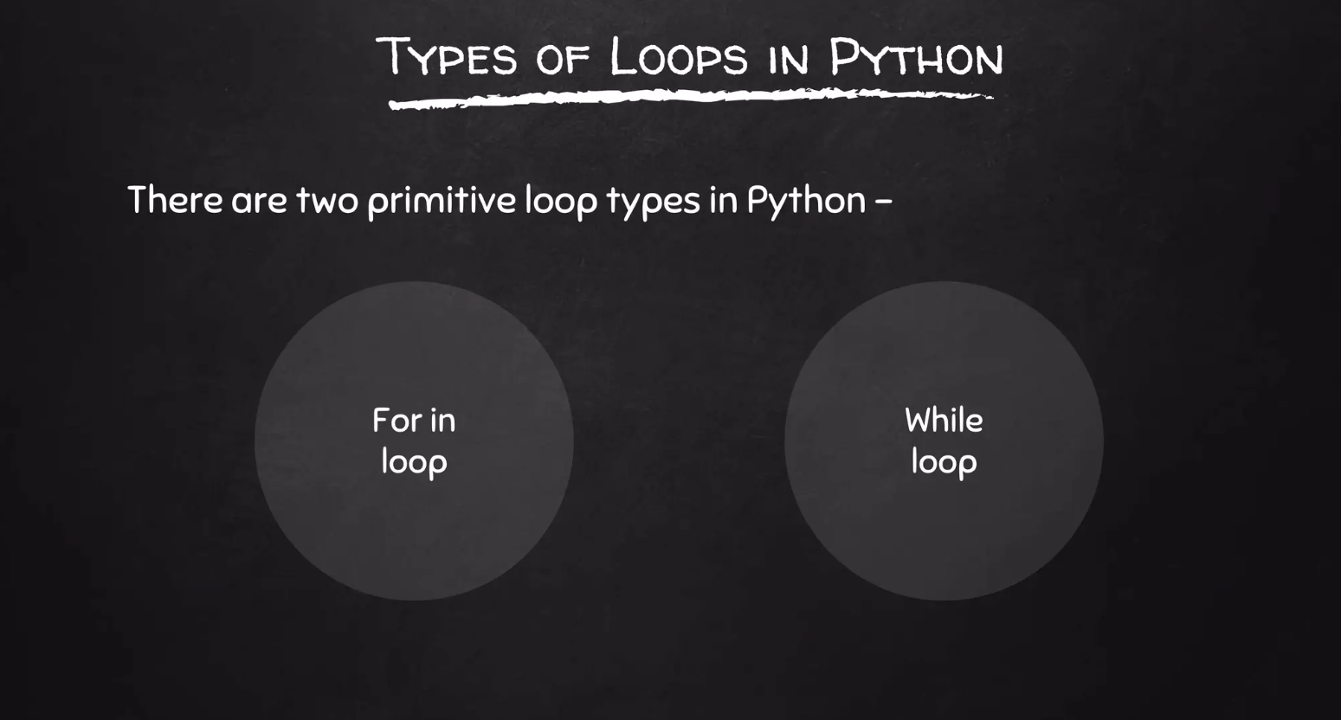


Loops and Iteration
Chapter 5
Python for Everybody
www.py4e.com
Notes:
Note from Chuck. If you are using these materials, you can remove the UM logo and replace it with your own, but please retain the CC-BY logo on the first page as well as retain the acknowledgement page(s) at the end.

Slide 58
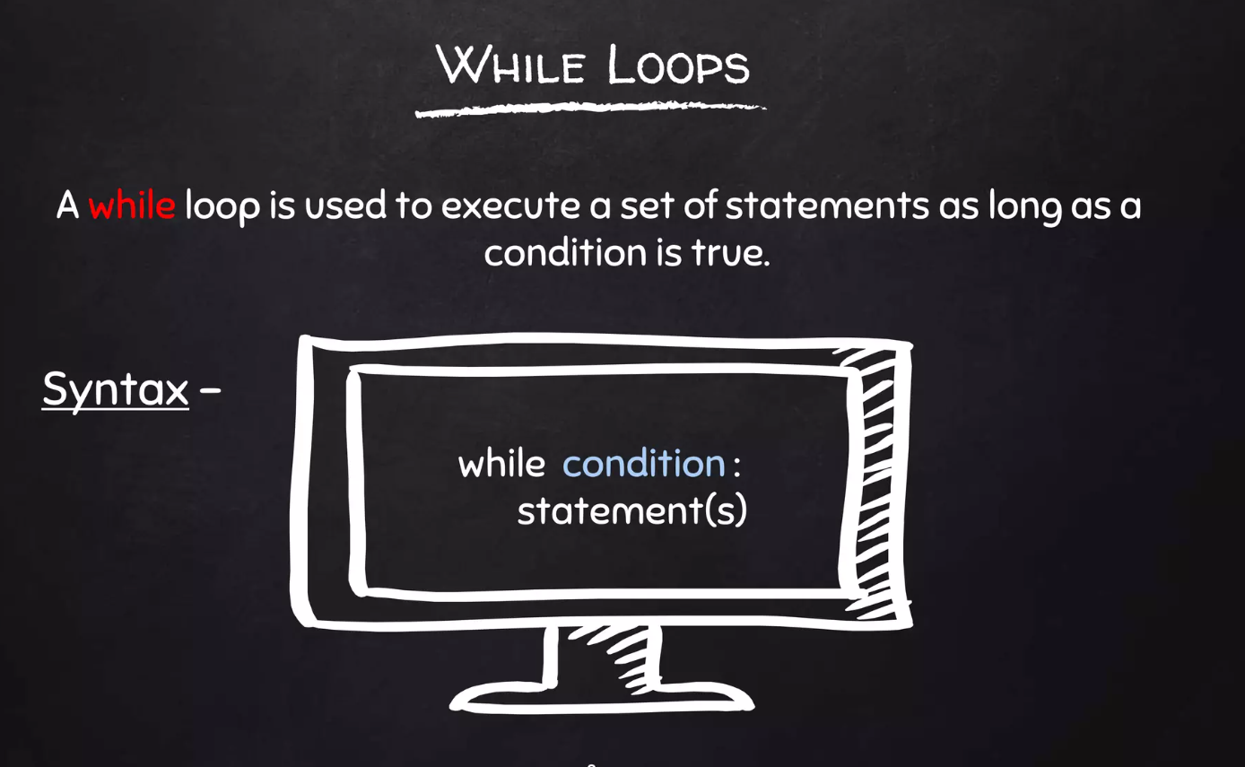
Loops and Iteration
Chapter 5
Python for Everybody
www.py4e.com
Notes:
Note from Chuck. If you are using these materials, you can remove the UM logo and replace it with your own, but please retain the CC-BY logo on the first page as well as retain the acknowledgement page(s) at the end.

Slide 59
Repeated Steps
n = 5
Program:
n = 5
while n > 0 :
print(n)
n = n – 1
print('Blastoff!')
print(n)
Output:
5
4
3
2
1
Blastoff!
0
No
n > 0 ?
Yes
print(n)
n = n -1
Loops (repeated steps) have iteration variables that change each time through a loop. Often these iteration variables go through a sequence of numbers.
print('Blastoff')

Slide 60
An Infinite Loop
n = 5
No
n > 0 ?
Yes
n = 5
while n > 0 :
print('Lather')
print('Rinse')
print('Dry off!')
print('Lather')
print('Rinse')
print('Dry off!')
What is wrong with this loop?

Slide 61
Another Loop
n = 0
No
n > 0 ?
Yes
n = 0
while n > 0 :
print('Lather')
print('Rinse')
print('Dry off!')
print('Lather')
print('Rinse')
print('Dry off!')
What is this loop doing?

Slide 62
Breaking Out of a Loop
The break statement ends the current loop and jumps to the statement immediately following the loop
It is like a loop test that can happen anywhere in the body of the loop
while True:
line = input('> ')
if line == 'done' :
break
print(line)
print('Done!')
> hello there
hello there
> finished
finished
> done
Done!

Slide 63
Breaking Out of a Loop
The break statement ends the current loop and jumps to the statement immediately following the loop
It is like a loop test that can happen anywhere in the body of the loop
while True:
line = input('> ')
if line == 'done' :
break
print(line)
print('Done!')
> hello there
hello there
> finished
finished
> done
Done!

Slide 64
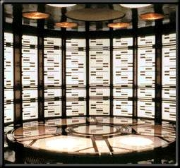
while True:
line = input('> ')
if line == 'done' :
break
print(line)
print('Done!')
No
True ?
Yes
....
break
...
http://en.wikipedia.org/wiki/Transporter_(Star_Trek)
print('Done')

Slide 65
Finishing an Iteration with continue
The continue statement ends the current iteration and jumps to the top of the loop and starts the next iteration
while True:
line = input('> ')
if line[0] == '#' :
continue
if line == 'done' :
break
print(line)
print('Done!')
> hello there
hello there
> # don't print this
> print this!
print this!
> done
Done!

Slide 66
Finishing an Iteration with continue
The continue statement ends the current iteration and jumps to the top of the loop and starts the next iteration
while True:
line = input('> ')
if line[0] == '#' :
continue
if line == 'done' :
break
print(line)
print('Done!')
> hello there
hello there
> # don't print this
> print this!
print this!
> done
Done!

Slide 67
No
True ?
Yes
while True:
line = raw_input('> ')
if line[0] == '#' :
continue
if line == 'done' :
break
print(line)
print('Done!')
....
continue
...
print('Done')

Slide 68
Indefinite Loops
While loops are called “indefinite loops” because they keep going until a logical condition becomes False
The loops we have seen so far are pretty easy to examine to see if they will terminate or if they will be “infinite loops”
Sometimes it is a little harder to be sure if a loop will terminate

Slide 69
Definite Loops
Iterating over a set of items…

Slide 70
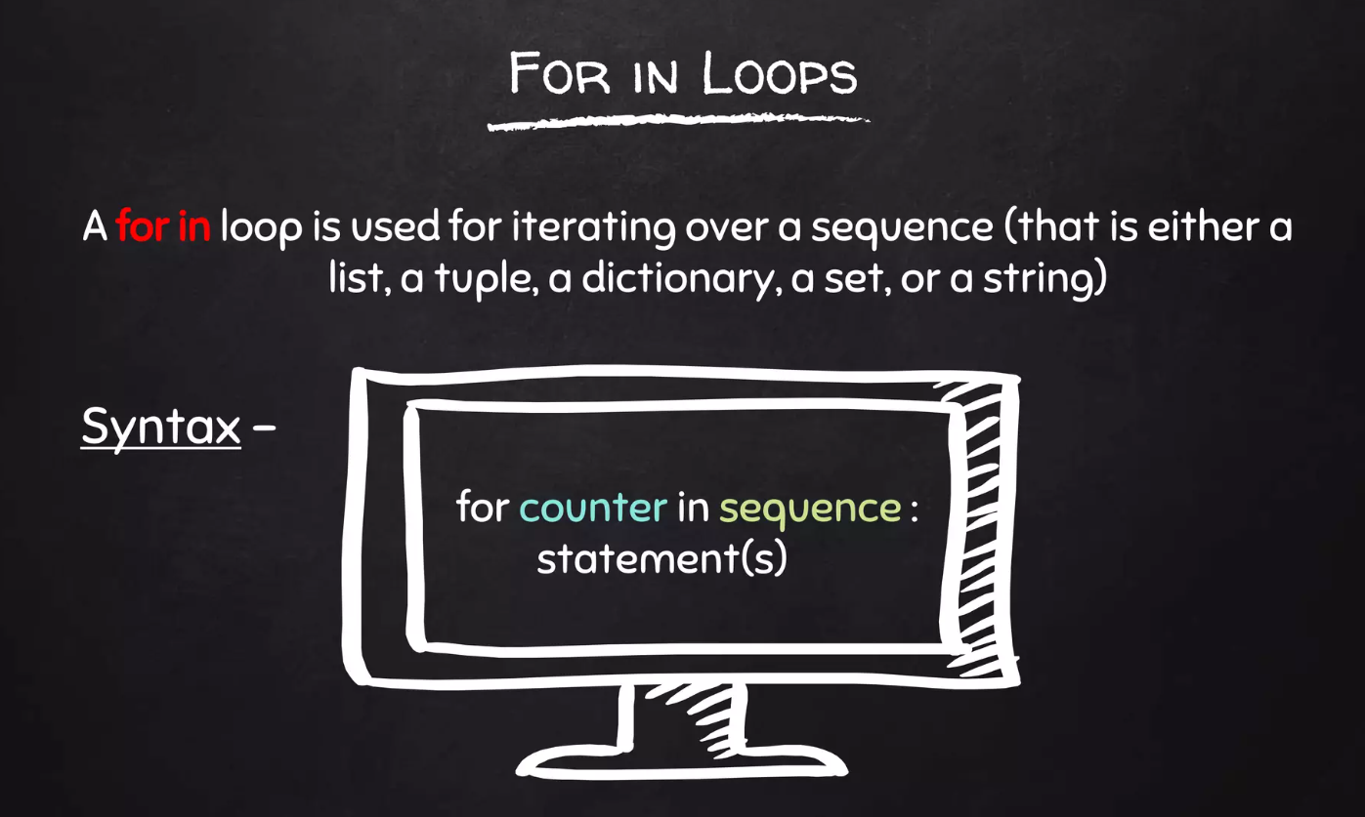
Definite Loops
Iterating over a set of items…

Slide 71
Definite Loops
Quite often we have a list of items of the lines in a file - effectively a finite set of things
We can write a loop to run the loop once for each of the items in a set using the Python for construct
These loops are called “definite loops” because they execute an exact number of times
We say that “definite loops iterate through the members of a set”

Slide 72
A Simple Definite Loop
5
4
3
2
1
Blastoff!
for i in [5, 4, 3, 2, 1] :
print(i)
print('Blastoff!')

Slide 73
A Definite Loop with Strings
Happy New Year: Joseph
Happy New Year: Glenn
Happy New Year: Sally
Done!
friends = ['Joseph', 'Glenn', 'Sally']
for friend in friends :
print('Happy New Year:', friend)
print('Done!')

Slide 74
A Simple Definite Loop
Yes
Done?
No
Move i ahead
5
4
3
2
1
Blastoff!
for i in [5, 4, 3, 2, 1] :
print(i)
print('Blastoff!')
print(i)
Definite loops (for loops) have explicit iteration variables that change each time through a loop. These iteration variables move through the sequence or set.
print('Blast off!')

Slide 75
Looking at in...
The iteration variable “iterates” through the sequence (ordered set)
The block (body) of code is executed once for each value in the sequence
The iteration variable moves through all of the values in the sequence
Five-element sequence
Iteration variable
for i in [5, 4, 3, 2, 1] :
print(i)

Slide 76
Yes
No
Done?
The iteration variable “iterates” through the sequence (ordered set)
The block (body) of code is executed once for each value in the sequence
The iteration variable moves through all of the values in the sequence
Move i ahead
print(i)
for i in [5, 4, 3, 2, 1] :
print(i)

Slide 77
i = 5
Yes
No
print(i)
Done?
Move i ahead
i = 4
print(i)
print(i)
i = 3
print(i)
i = 2
for i in [5, 4, 3, 2, 1] :
print(i)
print(i)
i = 1
print(i)

Slide 78
Loop Idioms:
What We Do in Loops
Note: Even though these examples are simple, the patterns apply to all kinds of loops

Slide 79
Making “smart” loops
The trick is “knowing” something about the whole loop when you are stuck writing code that only sees one entry at a time
Set some variables to initial values
for thing in data:
Look for something or do something to each entry separately, updating a variable
Look at the variables

Slide 80
Looping Through a Set
$ python basicloop.py
Before
9
41
12
3
74
15
After
print('Before')
for thing in [9, 41, 12, 3, 74, 15] :
print(thing)
print('After')

Slide 81
What is the Largest Number?

Slide 82
What is the Largest Number?
3

Slide 83
What is the Largest Number?
41

Slide 84
What is the Largest Number?
12

Slide 85
What is the Largest Number?
9

Slide 86
What is the Largest Number?
74

Slide 87
What is the Largest Number?
15

Slide 88
What is the Largest Number?

Slide 89
What is the Largest Number?
3
41
12
9
74
15

Slide 90
What is the Largest Number?
largest_so_far
-1

Slide 91
What is the Largest Number?
3
largest_so_far
3

Slide 92
What is the Largest Number?
41
largest_so_far
41

Slide 93
What is the Largest Number?
12
largest_so_far
41

Slide 94
What is the Largest Number?
9
largest_so_far
41

Slide 95
What is the Largest Number?
74
largest_so_far
74

Slide 96
What is the Largest Number?
15
74

Slide 97
What is the Largest Number?
3
41
12
9
74
15
74

Slide 98
Finding the Largest Value
$ python largest.py
Before -1
9 9
41 41
41 12
41 3
74 74
74 15
After 74
largest_so_far = -1
print('Before', largest_so_far)
for the_num in [9, 41, 12, 3, 74, 15] :
if the_num > largest_so_far :
largest_so_far = the_num
print(largest_so_far, the_num)
print('After', largest_so_far)
We make a variable that contains the largest value we have seen so far. If the current number we are looking at is larger, it is the new largest value we have seen so far.

Slide 99
More Loop Patterns…

Slide 100
Counting in a Loop
$ python countloop.py
Before 0
1 9
2 41
3 12
4 3
5 74
6 15
After 6
zork = 0
print('Before', zork)
for thing in [9, 41, 12, 3, 74, 15] :
zork = zork + 1
print(zork, thing)
print('After', zork)
To count how many times we execute a loop, we introduce a counter variable that starts at 0 and we add one to it each time through the loop.

Slide 101
Summing in a Loop
$ python countloop.py
Before 0
9 9
50 41
62 12
65 3
139 74
154 15
After 154
zork = 0
print('Before', zork)
for thing in [9, 41, 12, 3, 74, 15] :
zork = zork + thing
print(zork, thing)
print('After', zork)
To add up a value we encounter in a loop, we introduce a sum variable that starts at 0 and we add the value to the sum each time through the loop.

Slide 102
Finding the Average in a Loop
$ python averageloop.py
Before 0 0
1 9 9
2 50 41
3 62 12
4 65 3
5 139 74
6 154 15
After 6 154 25.666
count = 0
sum = 0
print('Before', count, sum)
for value in [9, 41, 12, 3, 74, 15] :
count = count + 1
sum = sum + value
print(count, sum, value)
print('After', count, sum, sum / count)
An average just combines the counting and sum patterns and divides when the loop is done.

Slide 103
Filtering in a Loop
print('Before')
for value in [9, 41, 12, 3, 74, 15] :
if value > 20:
print('Large number',value)
print('After')
$ python search1.py
Before
Large number 41
Large number 74
After
We use an if statement in the loop to catch / filter the values we are looking for.

Slide 104
Search Using a Boolean Variable
$ python search1.py
Before False
False 9
False 41
False 12
True 3
True 74
True 15
After True
found = False
print('Before', found)
for value in [9, 41, 12, 3, 74, 15] :
if value == 3 :
found = True
print(found, value)
print('After', found)
If we just want to search and know if a value was found, we use a variable that starts at False and is set to True as soon as we find what we are looking for.

Slide 105
How to Find the Smallest Value
$ python largest.py
Before -1
9 9
41 41
41 12
41 3
74 74
74 15
After 74
largest_so_far = -1
print('Before', largest_so_far)
for the_num in [9, 41, 12, 3, 74, 15] :
if the_num > largest_so_far :
largest_so_far = the_num
print(largest_so_far, the_num)
print('After', largest_so_far)
How would we change this to make it find the smallest value in the list?

Slide 106
Finding the Smallest Value
smallest_so_far = -1
print('Before', smallest_so_far)
for the_num in [9, 41, 12, 3, 74, 15] :
if the_num < smallest_so_far :
smallest_so_far = the_num
print(smallest_so_far, the_num)
print('After', smallest_so_far)
We switched the variable name to smallest_so_far and switched the > to <

Slide 107
Finding the Smallest Value
$ python smallbad.py
Before -1
-1 9
-1 41
-1 12
-1 3
-1 74
-1 15
After -1
smallest_so_far = -1
print('Before', smallest_so_far)
for the_num in [9, 41, 12, 3, 74, 15] :
if the_num < smallest_so_far :
smallest_so_far = the_num
print(smallest_so_far, the_num)
print('After', smallest_so_far)
We switched the variable name to smallest_so_far and switched the > to <

Slide 108
Finding the Smallest Value
smallest = None
print('Before')
for value in [9, 41, 12, 3, 74, 15] :
if smallest is None :
smallest = value
elif value < smallest :
smallest = value
print(smallest, value)
print('After', smallest)
$ python smallest.py
Before
9 9
9 41
9 12
3 3
3 74
3 15
After 3
We still have a variable that is the smallest so far. The first time through the loop smallest is None, so we take the first value to be the smallest.

Slide 109
The is and is not Operators
Python has an is operator that can be used in logical expressions
Implies “is the same as”
Similar to, but stronger than ==
is not also is a logical operator
smallest = None
print('Before')
for value in [3, 41, 12, 9, 74, 15] :
if smallest is None :
smallest = value
elif value < smallest :
smallest = value
print(smallest, value)
print('After', smallest)

Slide 110
Summary
While loops (indefinite)
Infinite loops
Using break
Using continue
None constants and variables
For loops (definite)
Iteration variables
Loop idioms
Largest or smallest

Slide 111
Acknowledgements / Contributions
These slides are Copyright 2010- Charles R. Severance (www.dr-chuck.com) of the University of Michigan School of Information and open.umich.edu and made available under a Creative Commons Attribution 4.0 License. Please maintain this last slide in all copies of the document to comply with the attribution requirements of the license. If you make a change, feel free to add your name and organization to the list of contributors on this page as you republish the materials.
Initial Development: Charles Severance, University of Michigan School of Information
… Insert new Contributors and Translators here
...

